Slide 1
Azure Active Directory
Speaker name
Speaker Title
twitter-handle or website

Slide 2
Agenda
What is Azure Active Directory
Azure AD and Developers
Visual Studio 2015 and Azure AD
Resources

Slide 3

What Is Azure Active Directory
A modern identity management system spanning cloud and on-premises

Slide 4
What Is Azure Active Directory
Provides federation, identity management, device registration, user provisioning, application access control & data protection

Slide 5
Enterprise Grade, at Cloud Scale
Every time you sign in with Office 365 or Azure, you are using Azure AD

Slide 6
Enterprise Grade, at Cloud Scale
Probably the largest enterprise identity and access solution on the planet

Slide 7
Enterprise Grade, at Cloud Scale
Probably the largest enterprise identity and access solution on the planet
18 Billion authentications
in a single week!

Slide 8
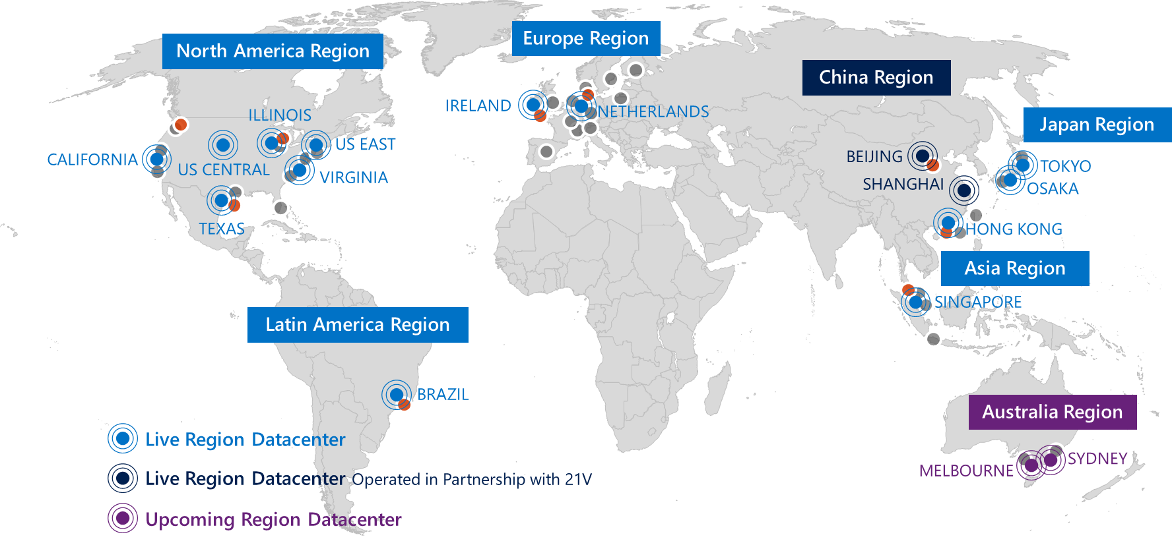
Enterprise Grade, at Cloud Scale
99.9% SLA
3x redundancy across datacenters throughout the world

Slide 9
Use Azure AD in Your Own Apps

Slide 10
Use Azure AD in Your Own Apps

Slide 11
Use Azure AD in Your Own Apps

Slide 12



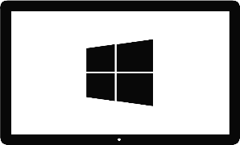


Platforms, Form Factors, Protocols
Azure Active Directory
OAuth2 &
OpenID Connect
SAML
WS-Federation
REST based Graph API

Slide 13
Demo

Slide 14
Resources
azure.com/aad
github.com/AzureAD
github.com/AzureADSamples

